Slide 1

Computer Security from an Example
CS-4440, Jun Xu
Spring 2022
Notes:
Thank Prof XXX very much for the warm welcome and introduction.
Good afternoon, everyone My name is Jun Xu and I am currently an assistant professor in Computer Science Department of Stevens Institute of Technology. Before that, I obtained my PhD degree from the
Cyber Security Lab at Pennsylvania State University. If you happen to know another Jun Xu, please do not be surprised, because there are over 70K people with this name from China.

Slide 2
Computer Security in Daily Life: A Real Case
Time: 2017 August
Location: Cyber Security Lab, Pennsylvania State University
Person: Visiting Professor Y from XIT
Background: Professor Y has worked on crypto for many years
Notes:
[figure] Recently, we’ve seen so many attacks, targeting not only our personal computer but also critical cyber infrastrcuture.
This is an example of cyber attack, (called) wannacry which happened in 2017.
In three days, it compromises millions of computers, and cost 4 billion dollars loss all over the world. In fact there are many similar attacks. Among them, you may have heard about the heartbleed attacks and Stuxnet attacks.
After we have seen these attacks, a natural question we might ask is where is our security solution when those attack happens.
To answer this question, I would like to show you the procedure of launching this attack.

Slide 3
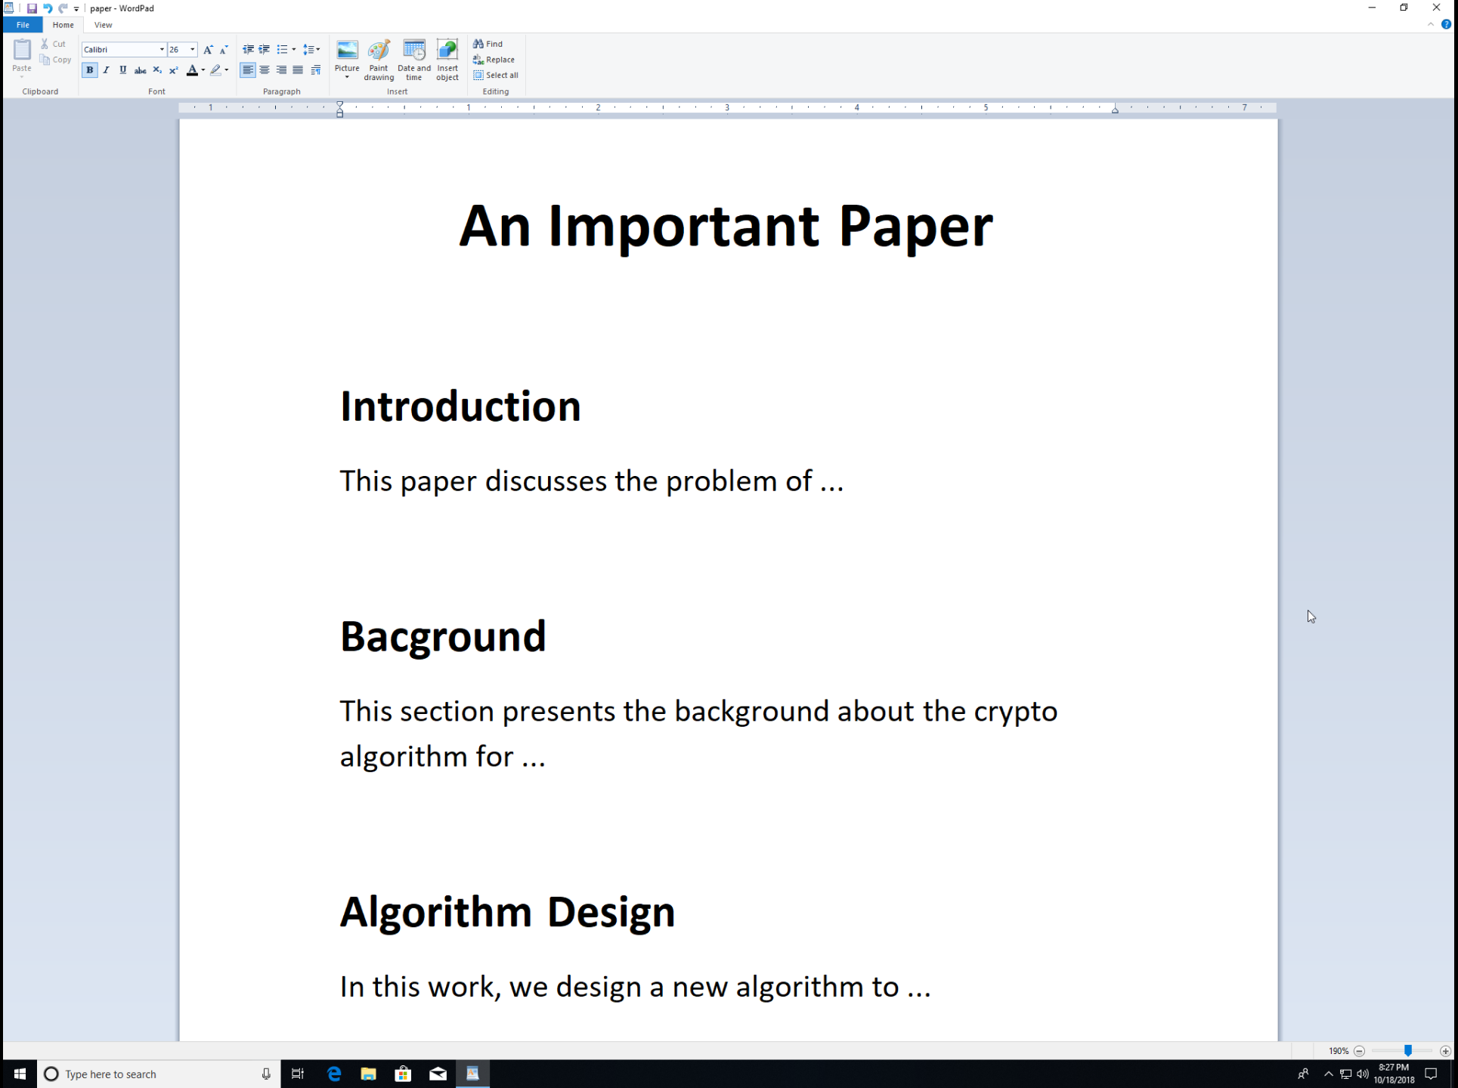
Beginning of the Story
Prof Y was writing an important paper
He aimed to submit it to a top conference at the end of August
It’s a critical piece for his promotion

Slide 4
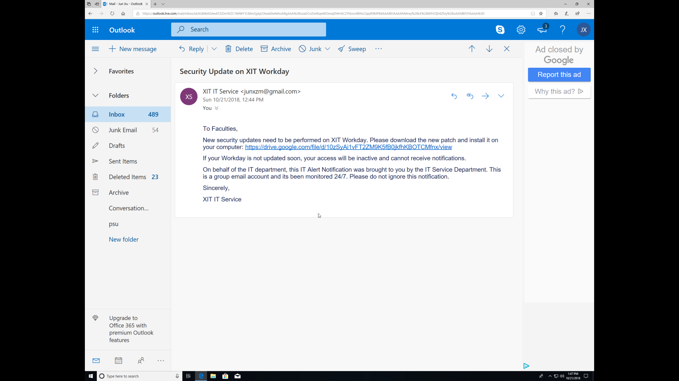
One Day, He Received an Email
He Checked the Subject:
Security Update of an Institute Level Software
He Checked the Sender:
It comes from the IT Service at XIT
He Checked the Link:
It is a google drive page (XIT common practice)

Slide 5
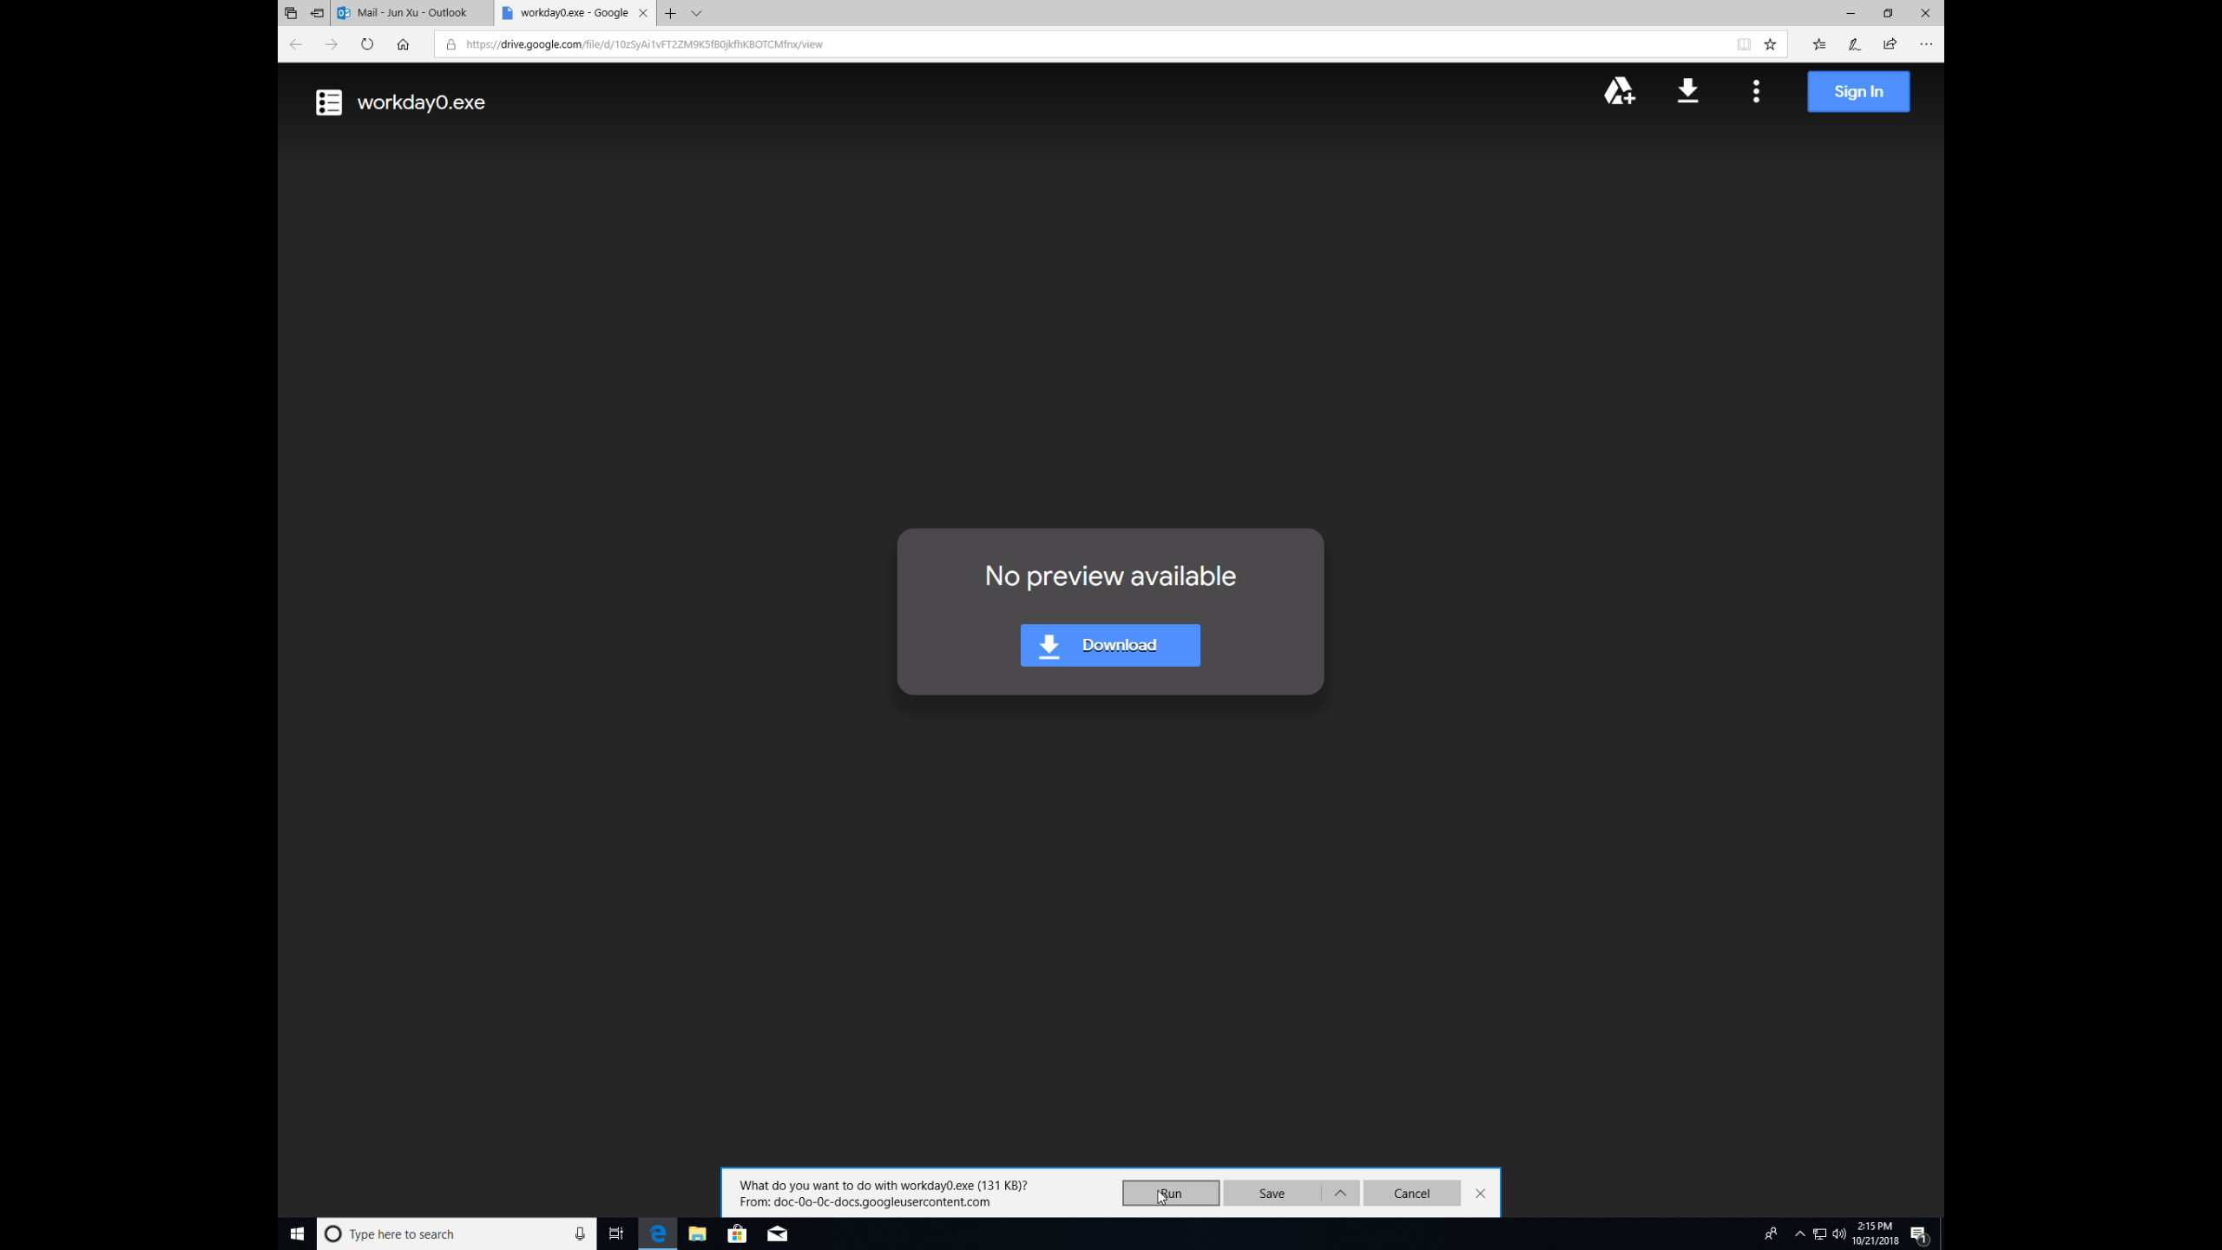
He Opened the Page for the New Software
He Checked the Software:
Correct Name
Correct Version
He Downloaded the File:
No Warning by Chrome
No Warning by Windows
He Ran It

Slide 6
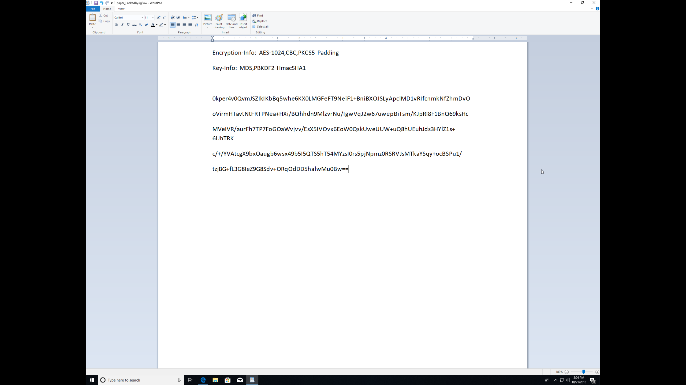
Five Minutes Later
He Checked His Paper:
Encrypted by AES-1024 [The Strongest Encryption Algorithm]

Slide 7
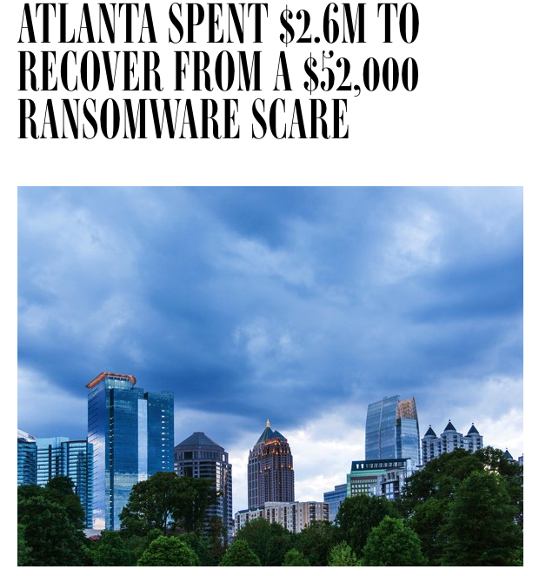
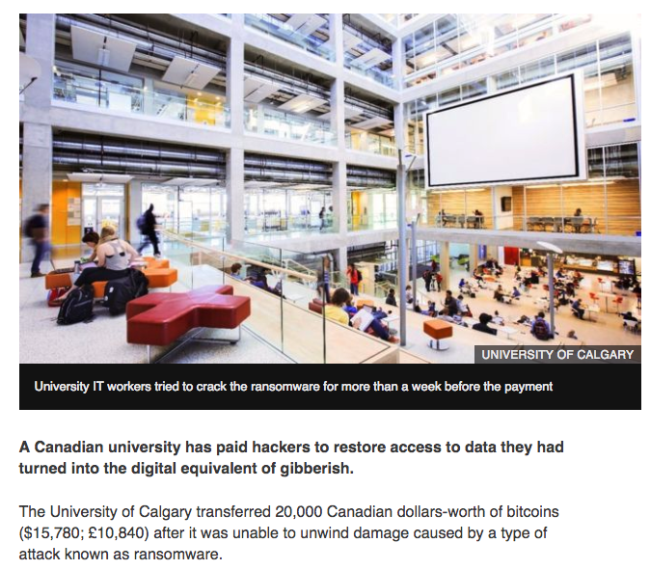
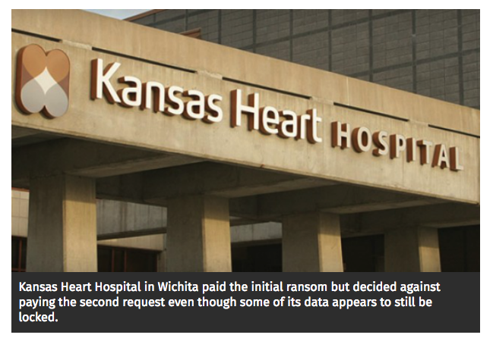
Ransomware in The World: Organization Victims
April 2018, the city of Atlanta paid 2.6M USD to recover data from ransomware
June 2016, University of Calgary paid 20K CAD for data locked by ransomware
May 2016, Kansas Heart paid a lot money to unlock data. TWICE!

Slide 8
Outline
How Ransomware Infects a Computer (the threats)
How Ransomware Works (the adversary mindset)
Can We Recover Data without Paying Ransom (the principles)
How to Protect Our Data (the techniques)

Slide 9
Infection Channels
How a ransomware propagates to the victim’s computer
Phishing email
Driven-by download
Vulnerability exploitation
There are also many other ways …

Slide 10
Infection Channel 1: Phishing Email
Infection Process
The attacker creates emails with deceptive subjects, fake sender identify, and links to ransomware
Send emails to victims
When victims open the link and run the software, infection succeeds
Deceptive Subject
Fake Sender
Information
Malicious Links

Slide 11
Infection Channel 2: Driven-by Download
Infection Process
Attacker injects malicious code into popular software
Attacker creates public and free access to the software
To save money or gain functionalities, victims download the software and run it
Free Download

Slide 12
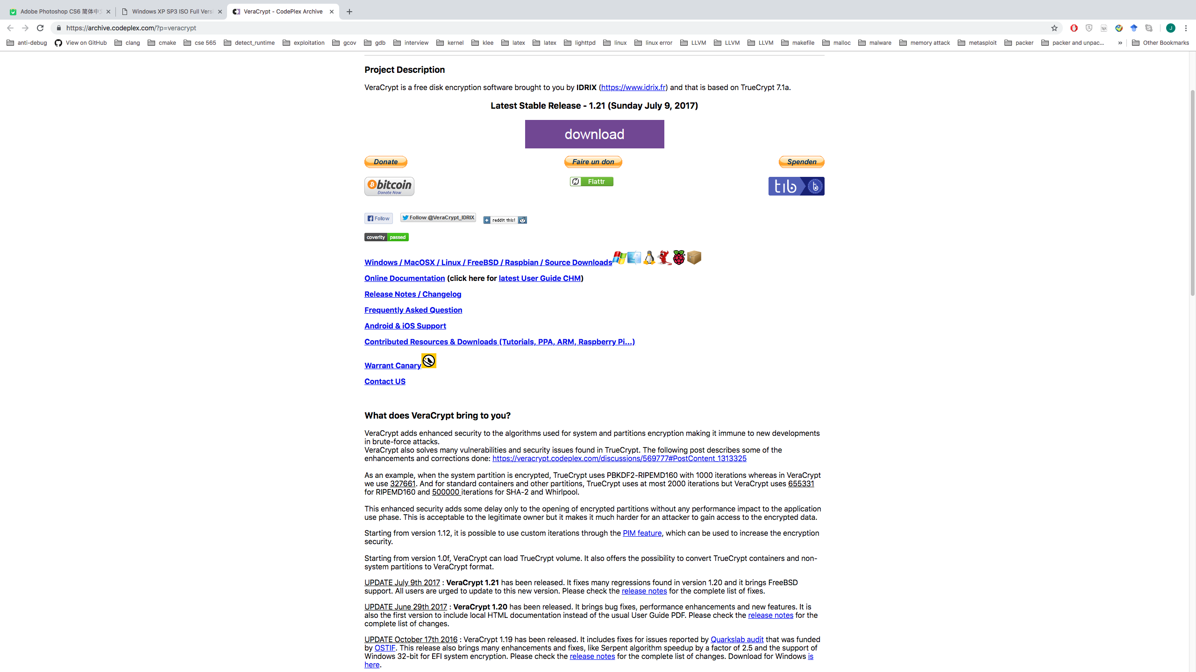
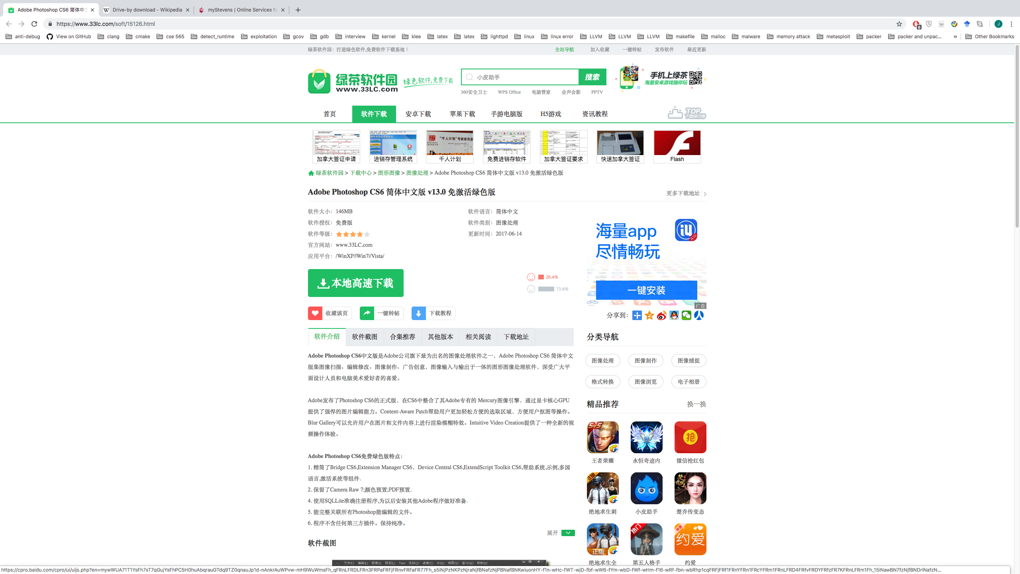
Infection Channel 2: Driven-by Download Examples
Impelling offers of open software downloads
Free Download
Free Download
Free version of Adobe Photoshop by Third Party
Free encryption utility by unauthenticated developers

Slide 13
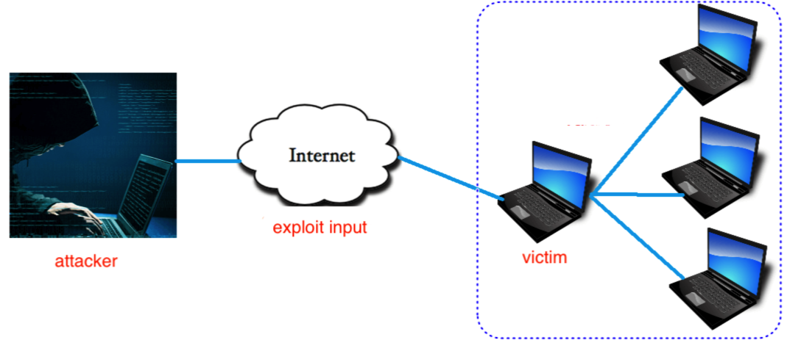
Infection Channel 3: Vulnerability Exploitation
Infection Process (proactive attack)
Attacker finds access to the victim’s machine
Attacker exploits a vulnerability in the victim’s machine
Attacker plants a ransomware
In the WannaCry attack, the attacker exploited a Windows vulnerability to plant encryption ransomware.
Why not Always Rely on Vulnerability Exploitation
for Infection?

Slide 14
Attacking Process
Communicate with the Control Server
Encrypt Files
Destroy Original Files and Keys
Ask for Ransom
Unlock File after Receiving Ransom

Slide 15
Attacking Step 1: Communicate with Control Server
Why Communicate?
Ransomware (victim)
Command and control server
Check liveness of the server
Send identify of the victim
1. Identity of the victim
Confirm victim identify (avoid repeated infection)
Echo confirmation of attack
2. attack command
Request keys to serve file encryption
3. request encryption keys
4. encryption keys
Send encryption keys

Slide 16
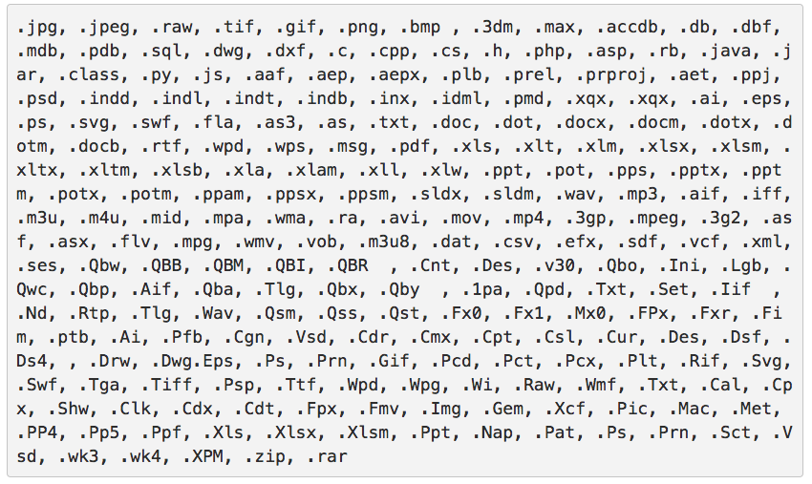
Attacking Step 2: Encrypt Files
Step 1: Traverse the file system
Breadth-first search
Depth-first search
Step 2: Filtering unwanted files
Only consider files with certain extensions
Step 3: Encrypt a file
file ⌾ key = encrypted_file
⌾ is the encryption operation
Prof Jun Xu is giving a lecture on encryption ransomware
KEY: helloworldaeskey
z2PX4KI4CEFaP0An8gJkaE9TKBxTcGyGwVf2ik+zniNuGTQSm1nsrBMLyVCRqThhJbtkQnApmDi+cDrlHLkgHg==
Why not Other Data?

Slide 17
Attacking Step 3: Destroy Original Files and Keys
To prevent the victims from re-obtaining the data
The attacker deletes the original files
The attacker destroys the encryption keys
KEY 1: helloworldaeskey
KEY 2: helloworldseckey
KEY 3: helloworld3rdkey

Slide 18
Attacking Step 4: Asking for Ransom
Pop up a window and ask for ransom
Notify victims the infection of ransomware
Ask ransom (150 USD in Bitcoins) to a specified account
Bitcoins account
Why Use BitCoin?

Slide 19
Attacking Step 5: Unlock File after Receiving Ransom
Decrypt a file
Reverse process of encryption
encrypted_file ⌾’ key = file
Command and control server
Ransomware (victim)
z2PX4KI4CEFaP0An8gJkaE9TKBxTcGyGwVf2ik+zniNuGTQSm1nsrBMLyVCRqThhJbtkQnApmDi+cDrlHLkgHg==
1. confirm receival of ransom
2. request decryption key
KEY: helloworldaeskey
3. send decryption key
Prof Jun Xu is giving a lecture on encryption ransomware

Slide 20
Recovery from Infection without Paying Ransom?
Idea 1: Find Copies in a Different Disks
Idea 2: Break Encryption and Recover Data
Idea 3: Track Ransom to Identify the Attacker

Slide 21
Idea 1: Find Copies in Other Machines
Avoid paying ransom to recover data
It fully depends on LUCK
Many people do not transfer data between different storages

Slide 22
Idea 2: Break Encryption
Modern encryption algorithms are theoretically strong
The only way to break it is Brute Force (try all the possible keys)
To break a 128-bit AES encryption: 3.4 x 10³⁸ possibilities
Supercomputer: 10.51 x 10¹⁵ Flops (floating point operations per second)
No. of Flops required per combination check: 1000 [most optimistic]
No. of combination checks per second = (10.51 x 10¹⁵) / 1000 = 10.51 x 10¹²
No. of seconds in one Year = 365 x 24 x 60 x 60 = 31536000
No. of Years to break AES = (3.4 x 10³⁸) / [(10.51 x 10¹²) x 31536000] = 1 billion billion years

Slide 23
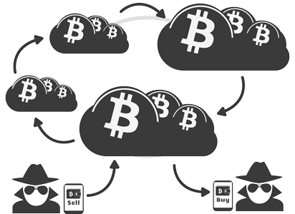
Idea 3: Track Ransom
Ransomware only takes bitcoins:
Attackers receive and sell bitcoins using their virtual wallet addresses
Wallet addresses contains no personally identifying information
A huge population are using bitcoins

Slide 24
Mitigations against Encryption Ransomware
First Line Mitigation: Avoid Infection
Free and Convenient Mitigation: Local Backup
Non-Free but Secure Mitigation: Remote Backup

Slide 25
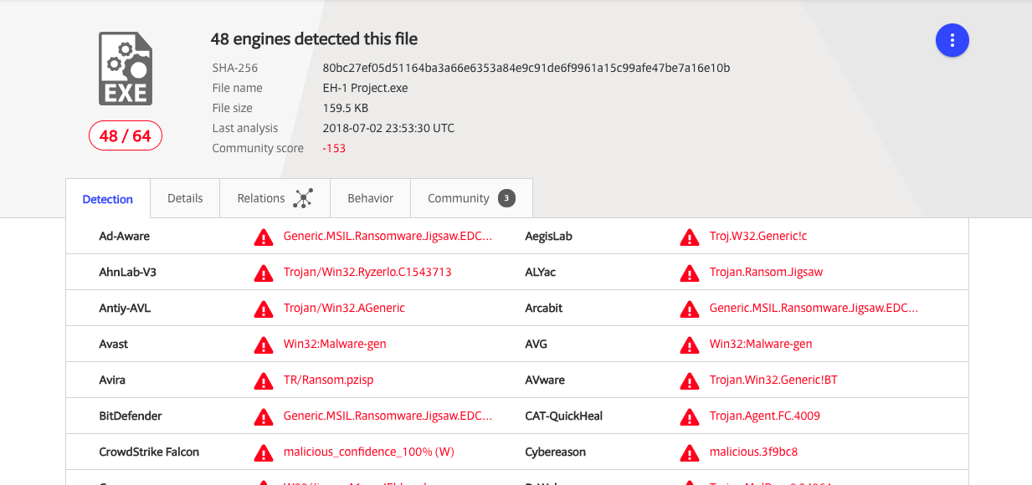
Publicly Available Mitigation 1: Avoid Infection
Idea 1: Avoid phishing email
Check address of sender
Double check authentication
Idea 2: Check every piece of software from untrusted sources
Idea 3: Run anti-virus software
Real-time detection
Available on all systems
VirusTotal: https://www.virustotal.com/#/home/upload
Free online check with over 50 anti-virus engine incorporated

Slide 26
Publicly Available Mitigation 2: Local Backup
Local Backup:
Backup data on the local disk periodically
Backups usually require higher privilege to access
Windows File Recovery: https://support.microsoft.com/en-us/help/17127/windows-back-up-restore
Linux Fwbackups: https://opensourceforu.com/2015/10/fwbackups-%C2%96-back-up-files-with-ease/
MacOS Time Machine:
https://support.apple.com/en-us/HT201250

Slide 27
Publicly Available Mitigation 2: Weakness of Local Backup
Local Backup is Not Secure
Many ransomware delete those backups
Many ransomware encrypt the whole disk

Slide 28
Publicly Available Mitigation 3: Remote Backup
Remote Backup:
Backup data on Cloud Storage
Real time backup
History tracking
Guaranteed recovery
When you open a new account, you may get free space as bonus.

Slide 29
Thanks!

